Slide 1

TENNIS ∩ STATISTICAL LEARNING
Applying Statistical Learning Techniques to Understand Professional Women’s Tennis
May, 2024
Presented by: Samaher Brahem

Slide 2



TABLE OF CONTENTS
Introduction
Unsupervised Learning
Supervised Learning
Challenges & Limitations

Slide 3
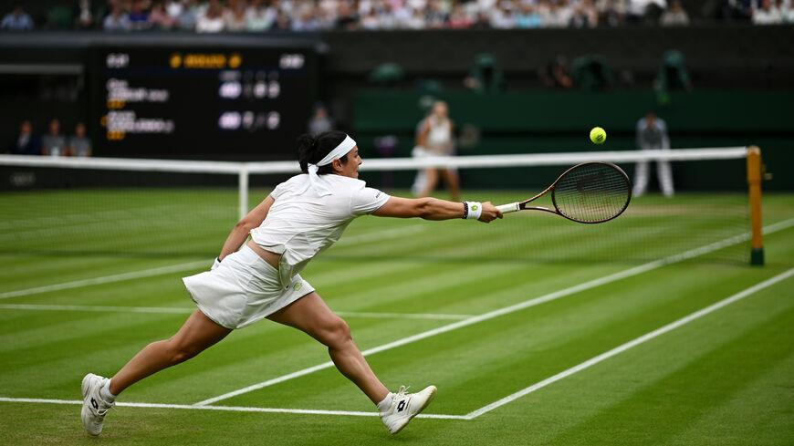
Introduction
INTRODUCTION

Slide 4
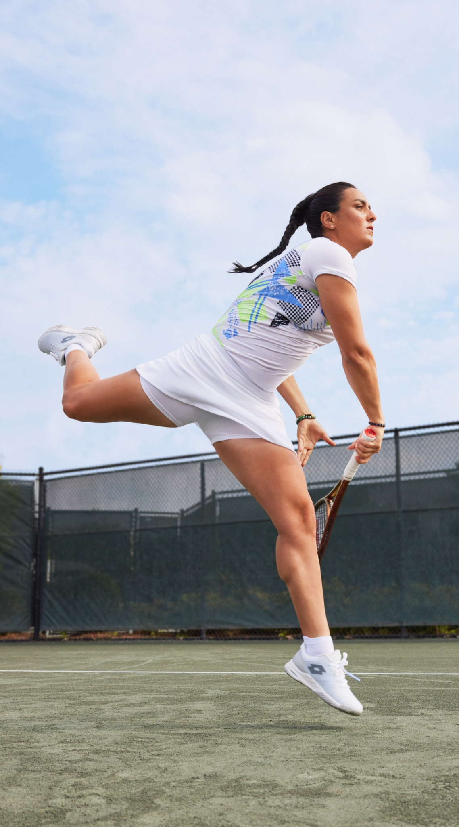
TENNIS 101
This project is conducted within the framework of the Statistical Learning course led by Prof. Silvia Salini at the University of Milan. Its core objectives entail the exploration and application of various statistical learning techniques, including both supervised and unsupervised learning paradigms.
POINTS
GAMES
SETS
MATCH
SERVE
DOUBLE FAULT
GRAND SLAM
BREAK POINT
ACE

Slide 5
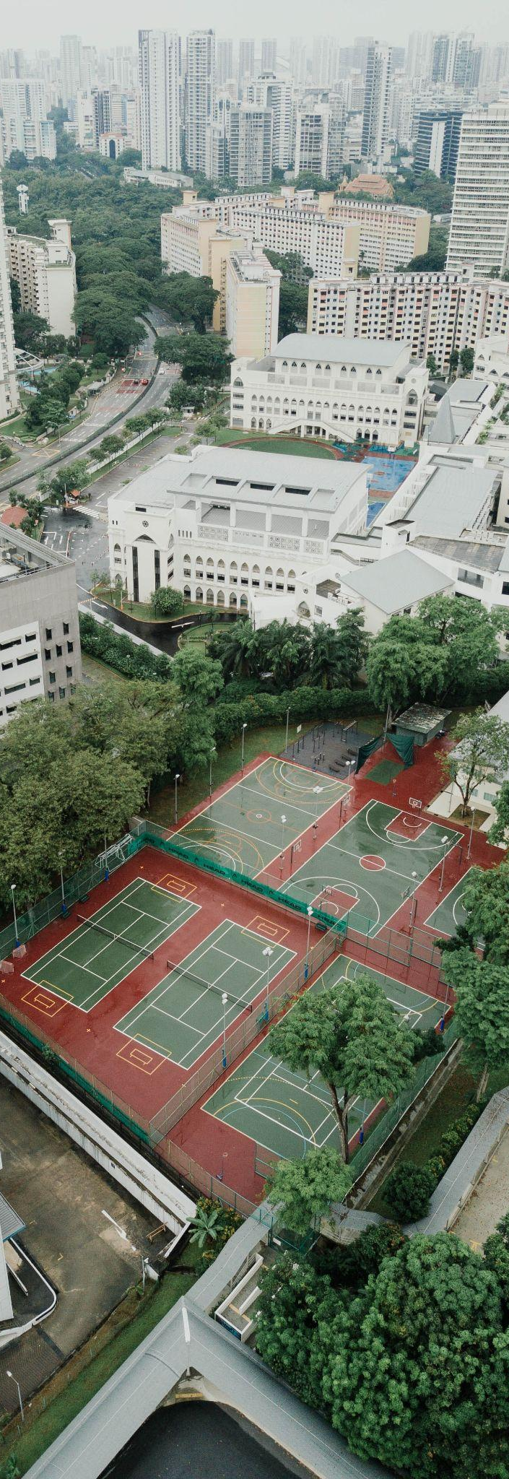



DATASET
Data Source: Github repository maintained by Jeff Sackmann
Initial Condition: 2,800 women’s singles WTA tour matches in the year 2023 | 50 Var
Winner & Loser Performance Stats
Winner & Loser Attributes
Match-Specific Details
nº of Aces
nº of Break Points Faced
nº of Break Points Saved
nº of Serves In
nº of Serves Won
Age
Height
Dominant Hand
Rank Points
WTA Rank
Match Score
Match Duration
Match Round
Tournament Name
Tournament Level

Slide 6
DATA PREPROCESSING
Null Values
Creating a Balanced Dataset
Score Column Transformation
Scaling Numerical Variables
Grand Slam & Final Rounds Encoding
Involving Top 100 Players’ Matches Only
Removing Unnecessary Variables
Outliers

Slide 7
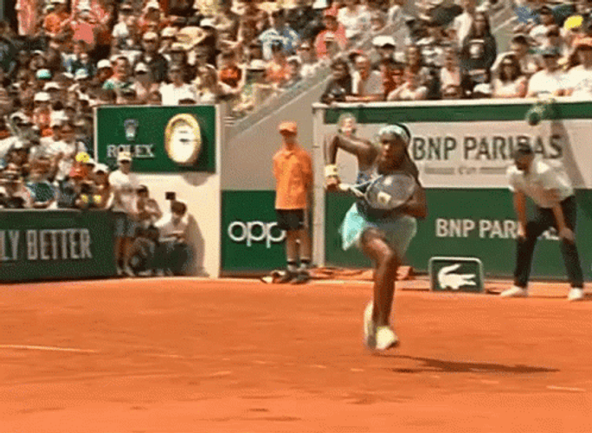
DATA PREPROCESSING
Null Values
Score Column Transformation
Grand Slam & Final Rounds Encoding
Removing Unnecessary Variables

Slide 8
DATA PREPROCESSING
Null Values
BEFORE:
SCORE
6-4 6-2
Score Column Transformation
AFTER:
Grand Slam & Final Rounds Encoding
w_set1 | L_set1 | w_set2 | L_set2
6 | 4 | 6 | 2
Removing Unnecessary Variables

Slide 9
DATA PREPROCESSING
Null Values
BEFORE:
AFTER:
tourney_level
G
PM
grand_slam
1
0
Score Column Transformation
Grand Slam & Final Rounds Encoding
round
QF or SF or F
R16
final_rounds
1
0
Removing Unnecessary Variables

Slide 10
DATA PREPROCESSING
Null Values
tourney_id
best_of
winner_id
loser_id
match_num
tourney_date
…
Score Column Transformation
Grand Slam & Final Rounds Encoding
Removing Unnecessary Variables

Slide 11
DATA PREPROCESSING
Creating a Balanced Dataset
BEFORE:
winner | loser
100% win rate | 0% win rate
Scaling Numerical Variables
AFTER:
Involving Top 100 Players’ Matches Only
player | opponent
50% win rate | 50% win rate
Outliers

Slide 12
DATA PREPROCESSING
Creating a Balanced Dataset
BEFORE:
AFTER:
player_ht
182
player_ht
1.17343760
Scaling Numerical Variables
FORMULA:
Involving Top 100 Players’ Matches Only
Original Value (182) - Mean (175.1)
Standard Deviation (5.898713)
Outliers

Slide 13
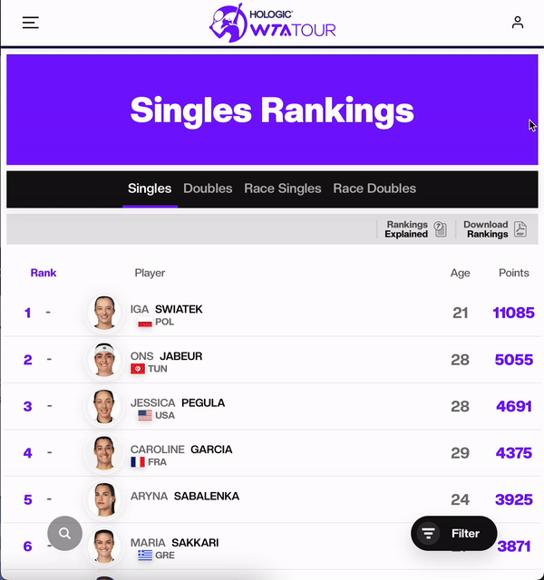
DATA PREPROCESSING
Creating a Balanced Dataset
Scaling Numerical Variables
Involving Top 100 Players’ Matches Only
Outliers

Slide 14
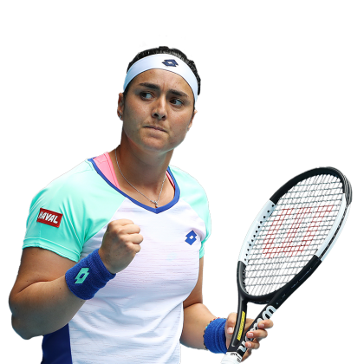
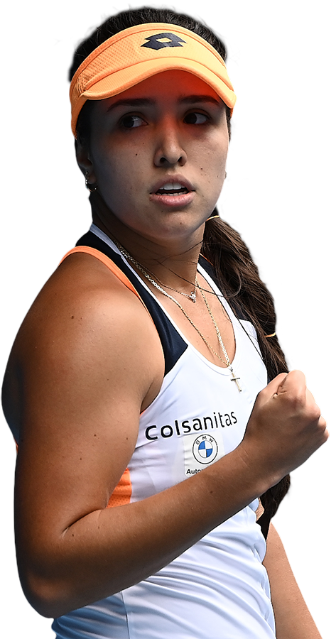
DATA PREPROCESSING
Creating a Balanced Dataset
MISTAKES:
Scaling Numerical Variables
Involving Top 100 Players’ Matches Only
Ons Jabeur | Camila Osorio
Match Duration | 316 ❌
Outliers
122 ✅

Slide 15

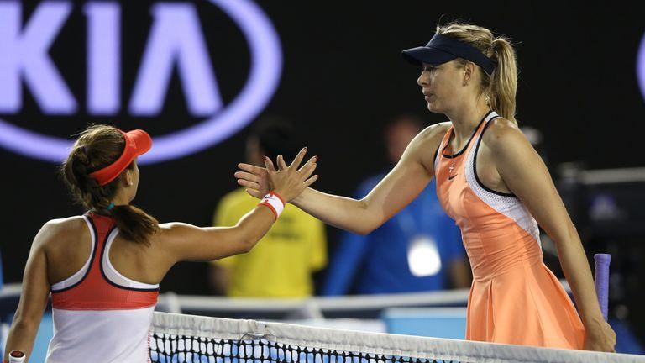
DATA PREPROCESSING
Creating a Balanced Dataset
REAL OUTLIERS:
player_ht (Lauren Davis) | 1.57m 🤔
Scaling Numerical Variables
Involving Top 100 Players’ Matches Only
Outliers

Slide 16
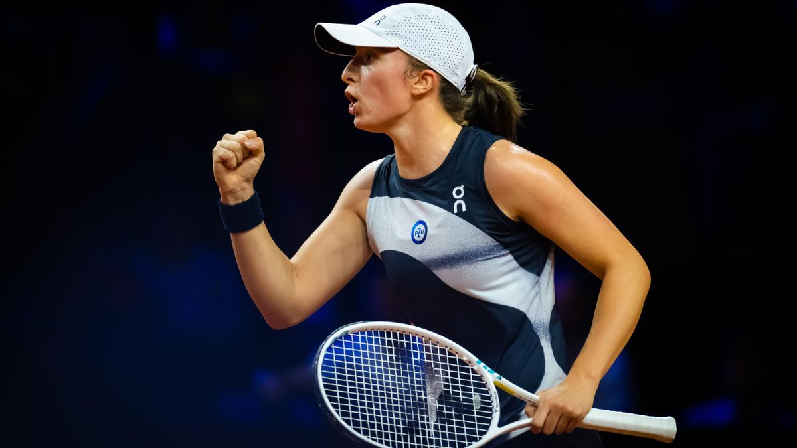
Introduction
UNSUPERVISED

Slide 17
Subset Chosen
player_name
avg_p_svpt
avg_p_SvGms
avg_p_ace
avg_p_1stWon
avg_p_bpSaved
avg_p_df
avg_p_2ndWon
avg_p_bpFaced
player-specific average match statistics

Slide 18
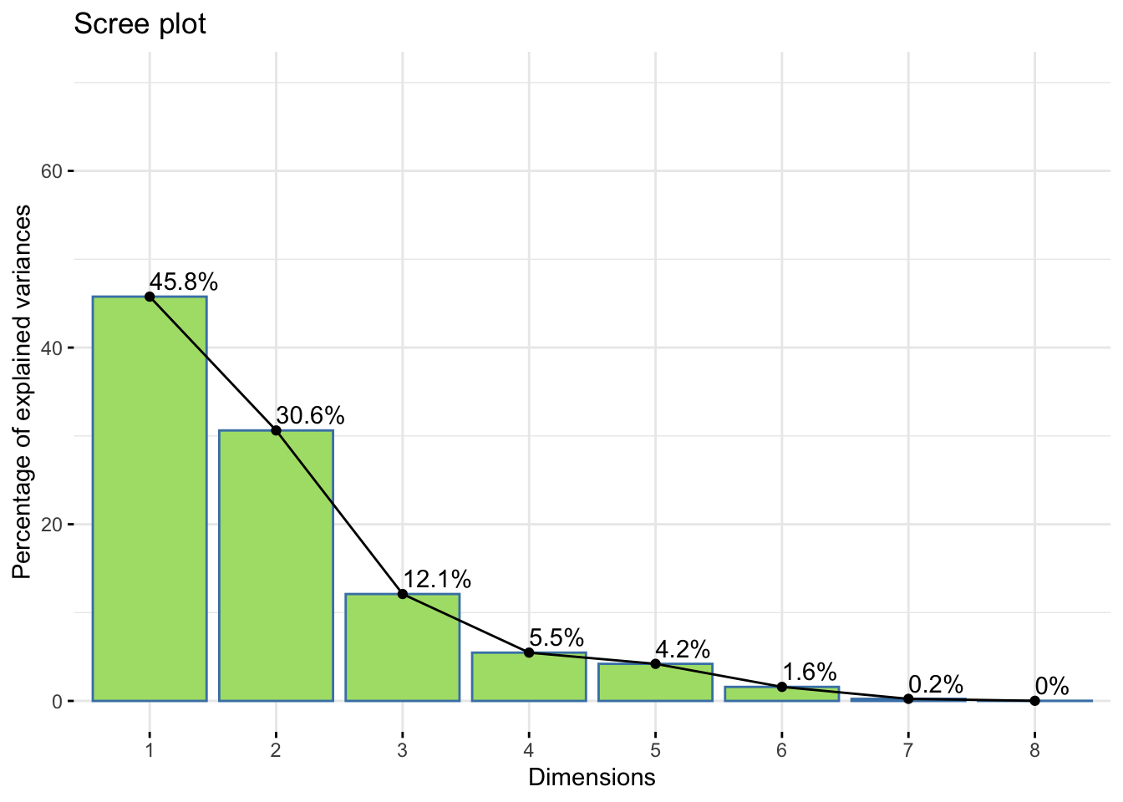
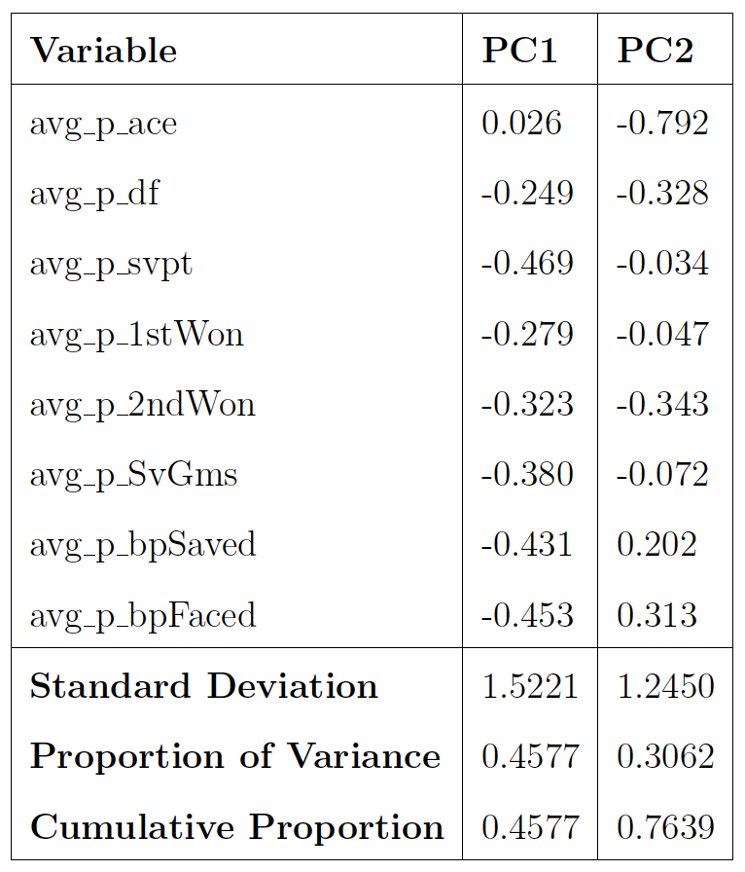
Principal Component Analysis
serving effectiveness & resilience
under pressure
aggressive serving strategies

Slide 19
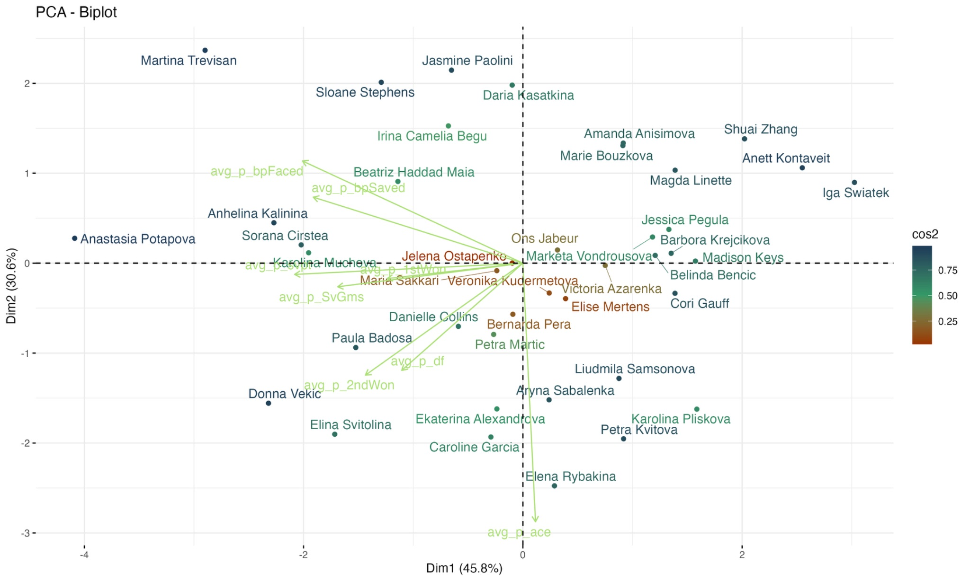
Principal Component Analysis
🎾 strong representation in the principal component space.
🎾 High PC1 values correlate with low averages in serve points, break points faced and saved, serve games played, and second serve points won.
🎾 Moderate representation in the principal component space.
🎾 Though less influential on PC1 and PC2 variability than blue-linked players, they still show noticeable patterns in their match statistics.
🎾 Weak representation in the principal component space.
🎾 Match statistics minimally contribute to the variability along PC1 & PC2, suggesting these players may lack significant trends or patterns in their gameplay.

Slide 20
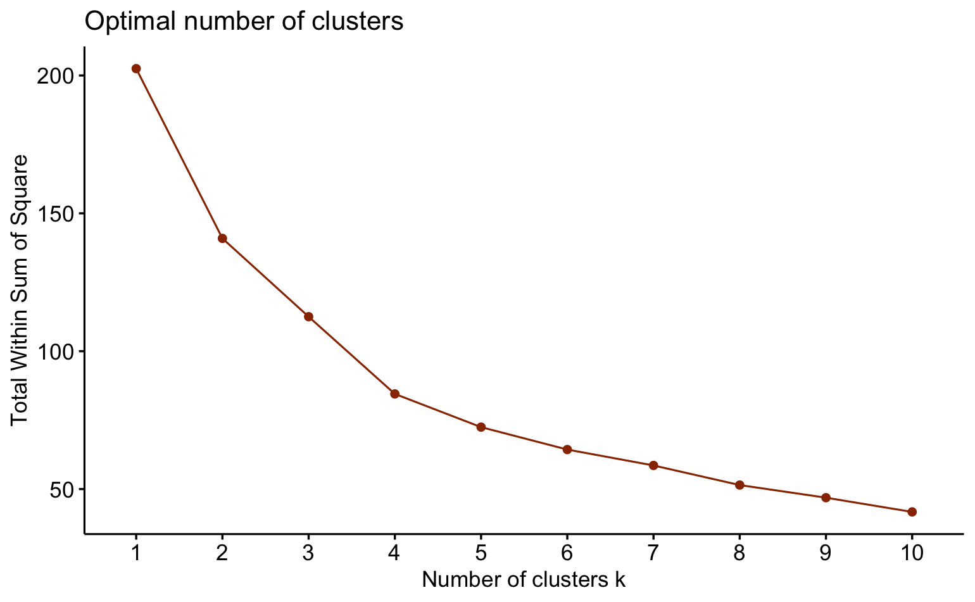
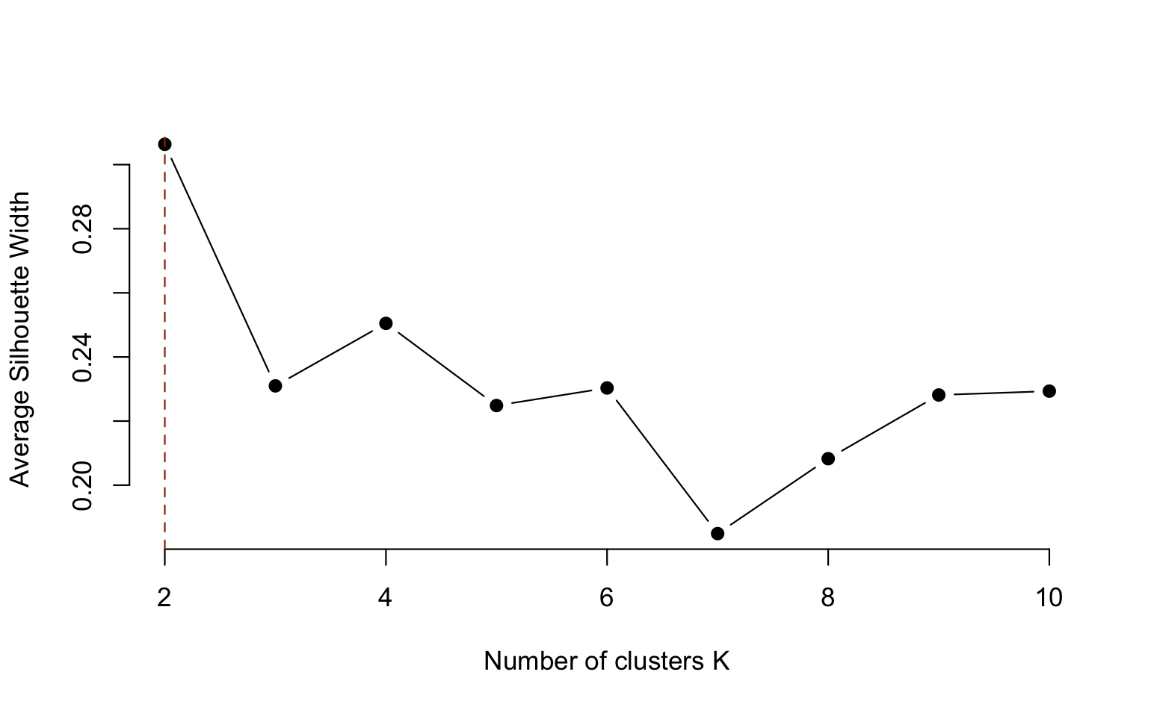
Clustering | K-medoids
💪 elbow method
👤 silhouette method

Slide 21
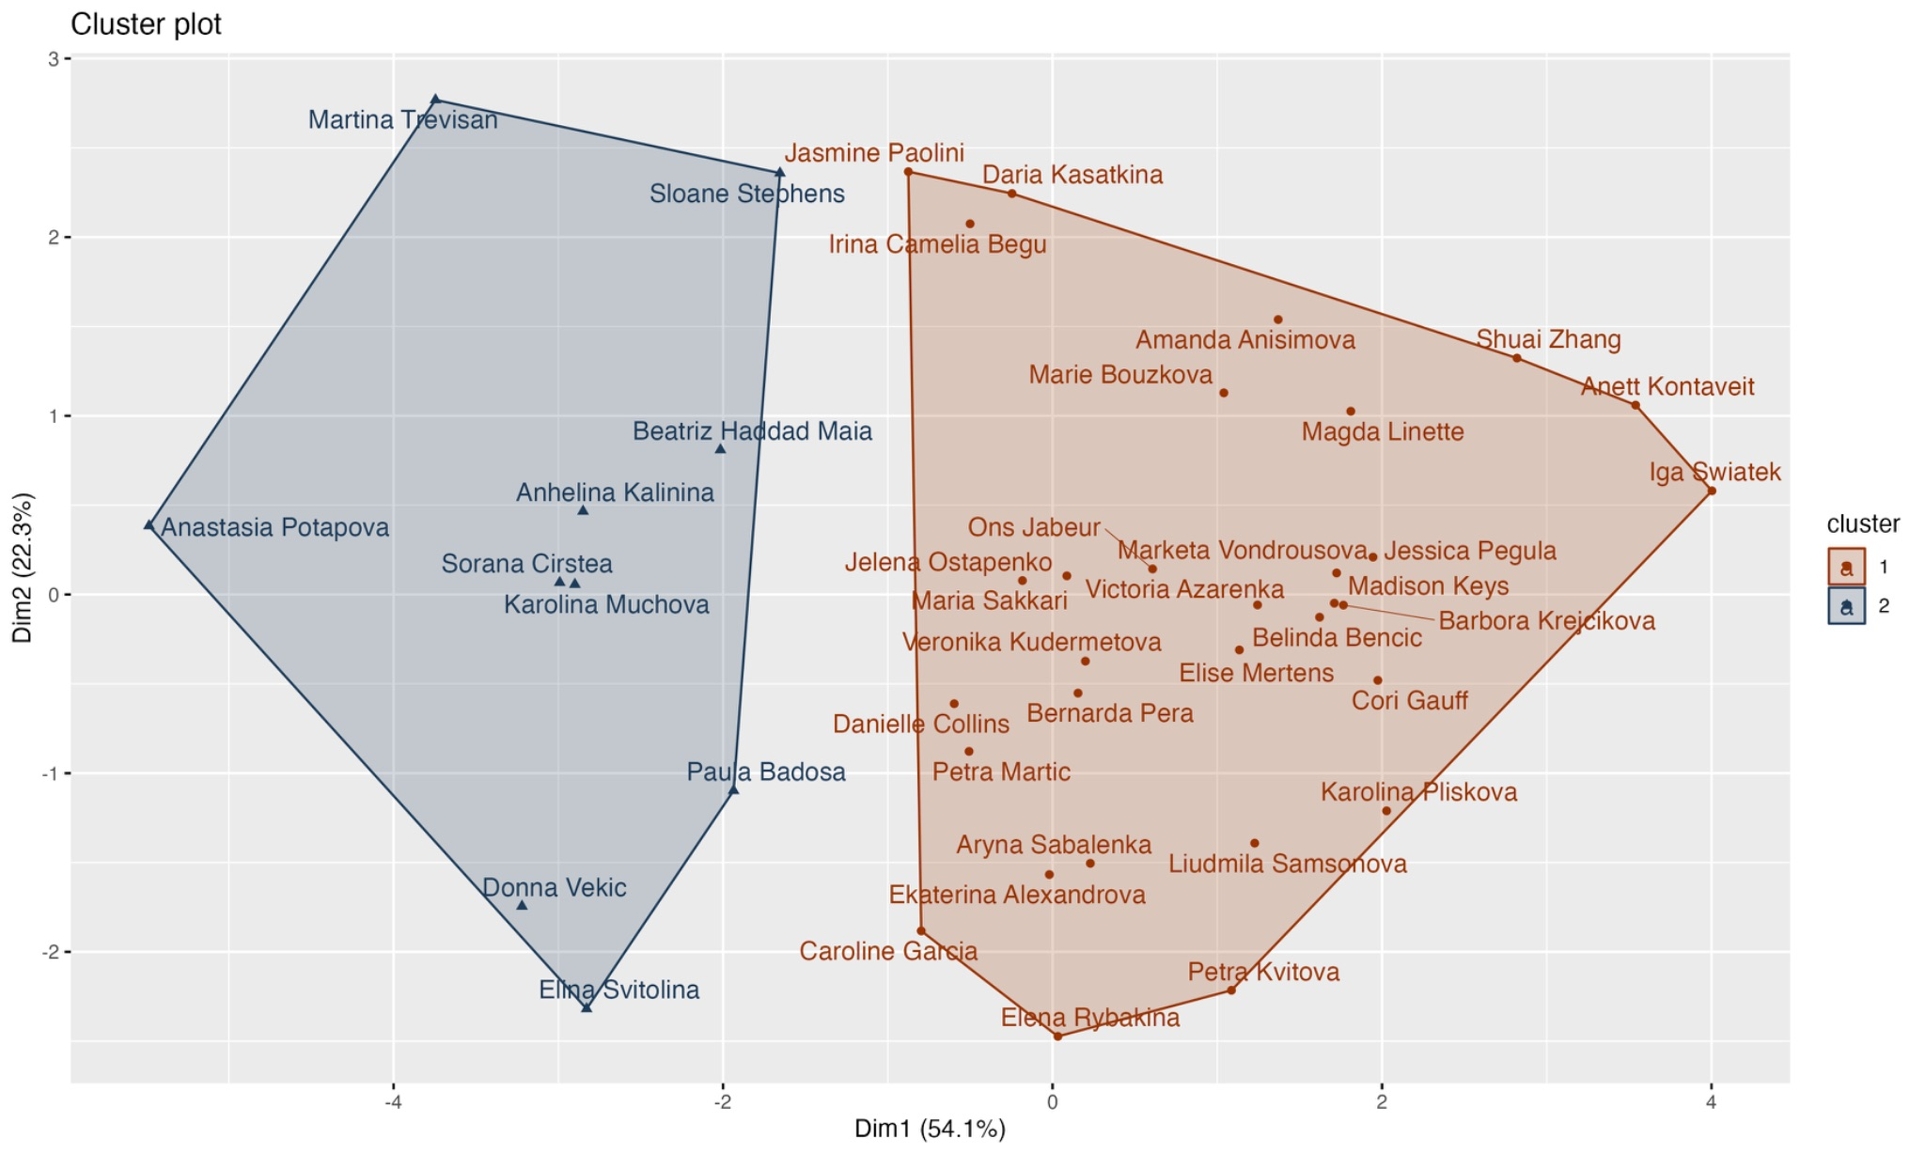
Clustering | K-medoids
The results reveal the presence of 2 distinct clusters.
Upon closer examination, we can see that cluster 1 comprises over 93% of the top 10 players.
This clustering aligns logically with the nature of tennis, as top players are expected to excel across various performance metrics discussed earlier.

Slide 22
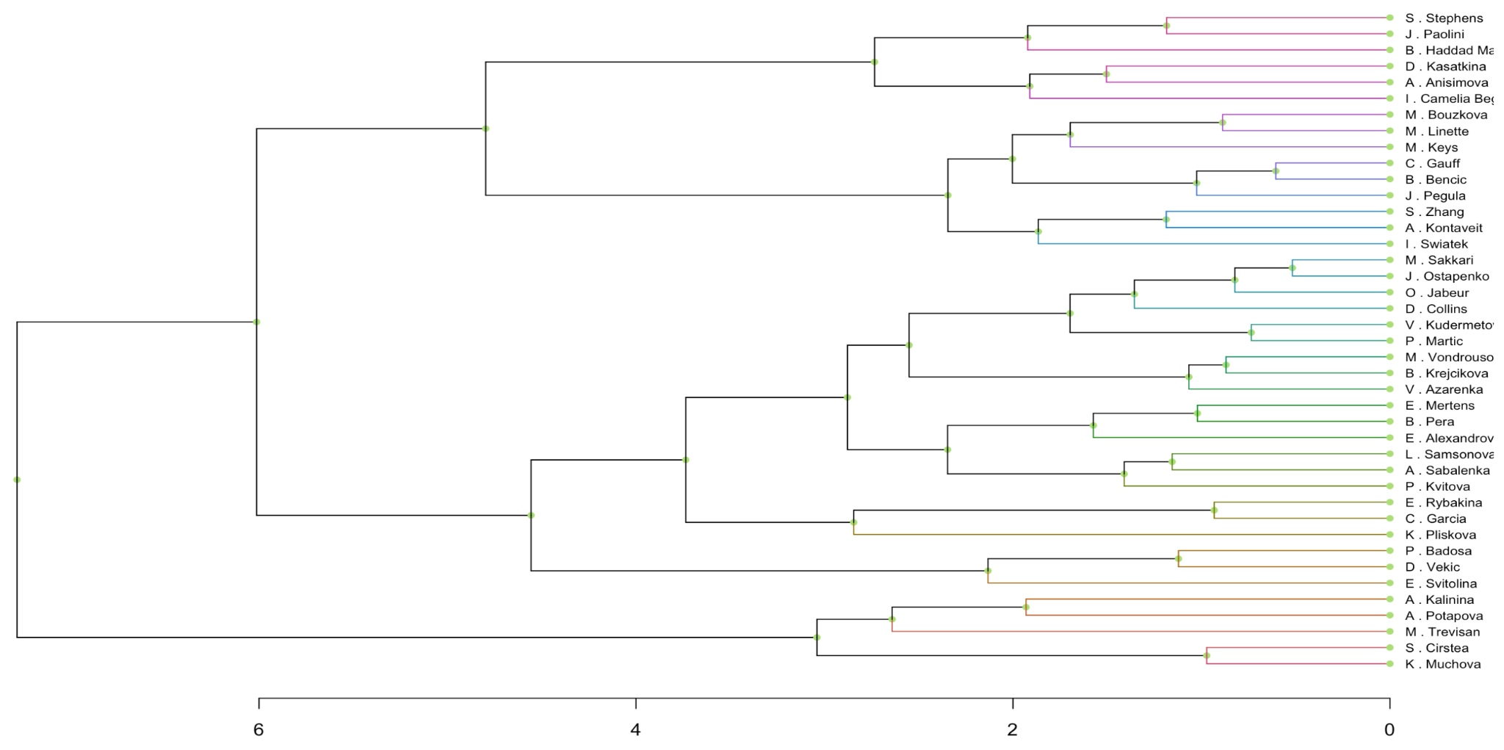
Clustering | Hierarchical Clustering - Complete
🎾 In complete linkage, the distance between two clusters is defined as the maximum distance between any pair of points in the two clusters.
🎾 It groups players who excel in certain aspects of the game while struggling in others, leading to distinctive clusters that highlight specific strengths and weaknesses.

Slide 23
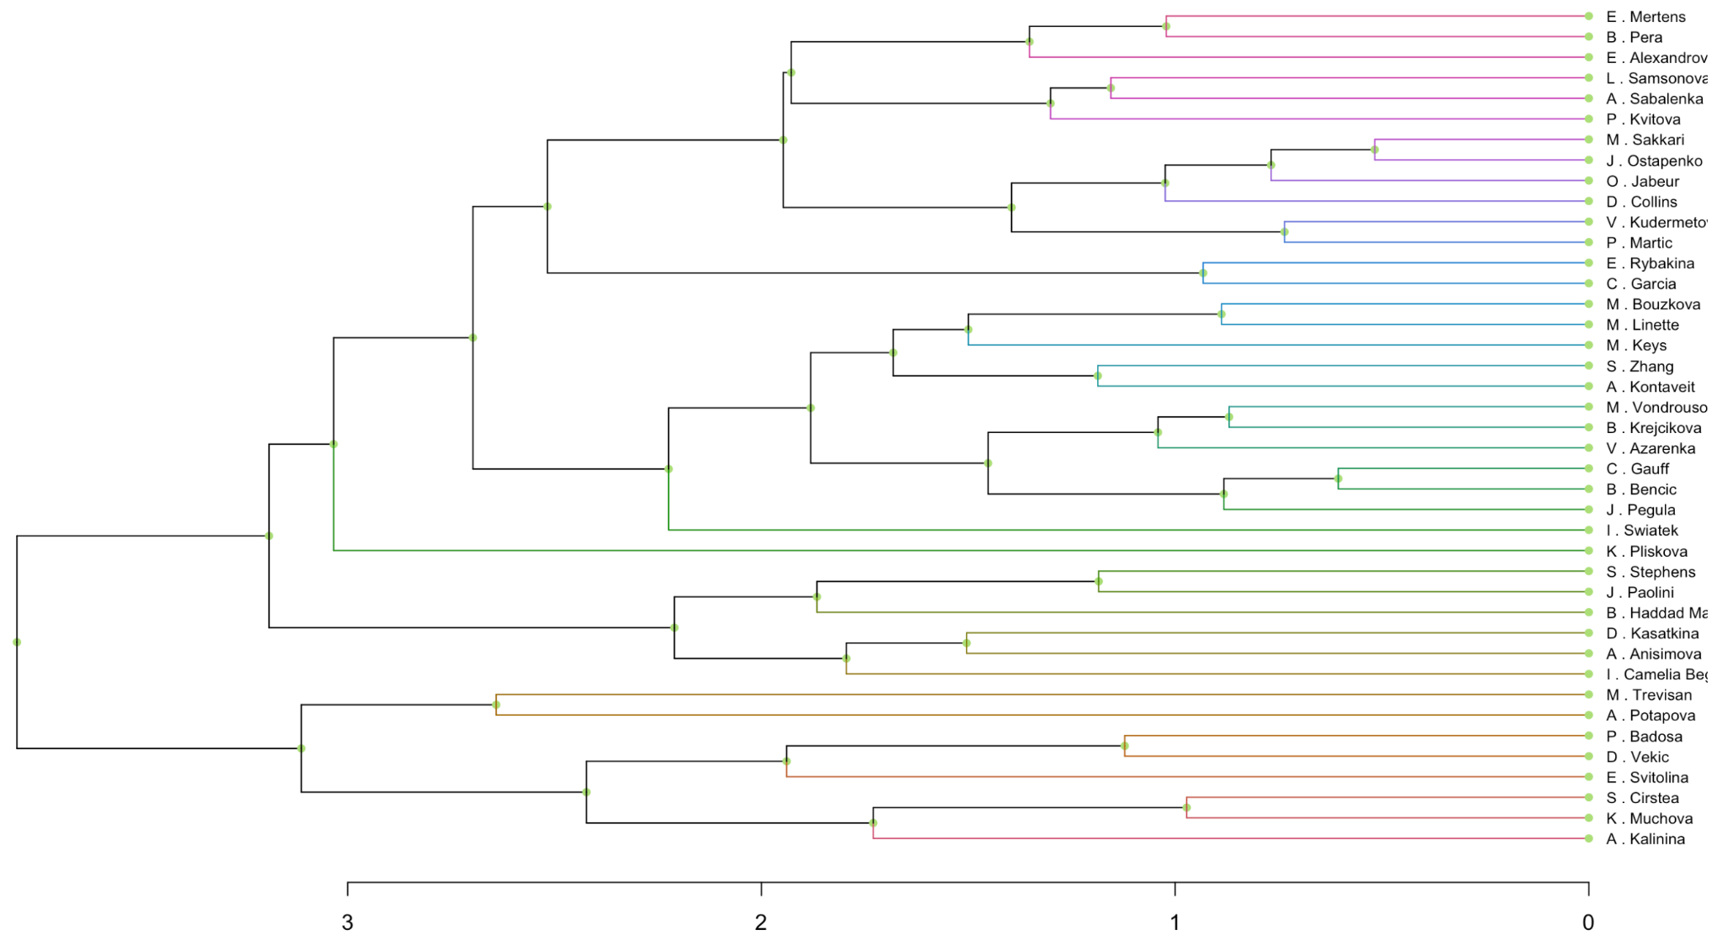
Clustering | Hierarchical Clustering - Average
🎾 Average linkage calculates the distance as the average of all pairwise distances between points in the two clusters.
🎾 It tends to create more evenly sized clusters by considering the collective performance of players. It can accommodate variations in player skill levels and playing styles, resulting in clusters that represent a balanced mix of different playerprofiles.

Slide 24
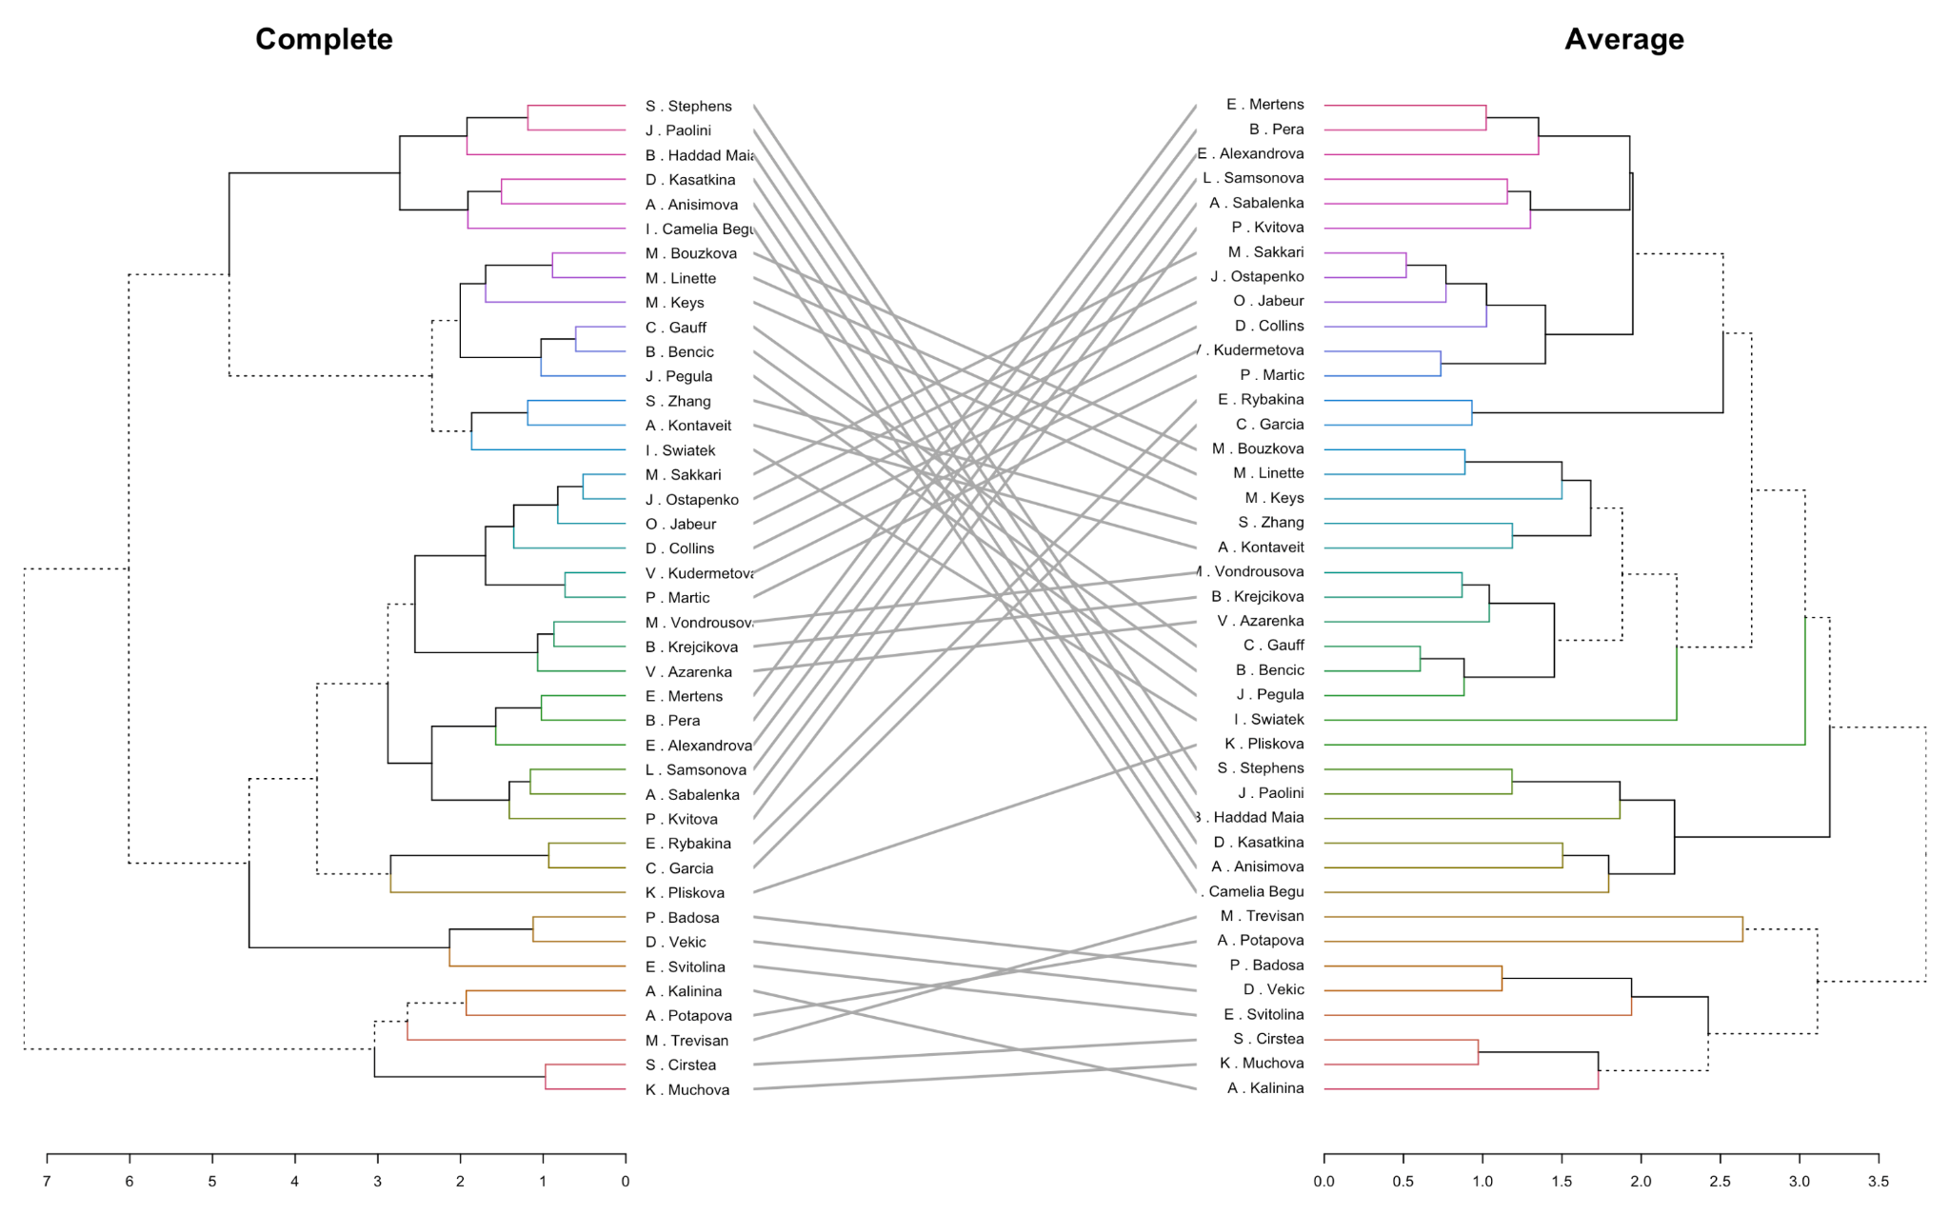
Clustering | Complete & Average 🤜 head-to-head 🤛
🎾 While the inter-cluster distances
exhibited variability, the clusters maintained consistent compositions. Notably, players like Kvitova, Samsonova, and Sabalenka known for their powerful serves and proficiency in scoring aces, consistently formed a cluster across both methods.
🎾 The proximity between Iga Swiantek and Anett Kontaveit in the complete method, indicates similarities in their playing styles. However, in the average method, this proximity was diminished, potentially influenced by their respective rankings in the 2023 season—Swiantek held the top rank while Kontaveit ranked 17th, reflecting differences in overall performance.

Slide 25
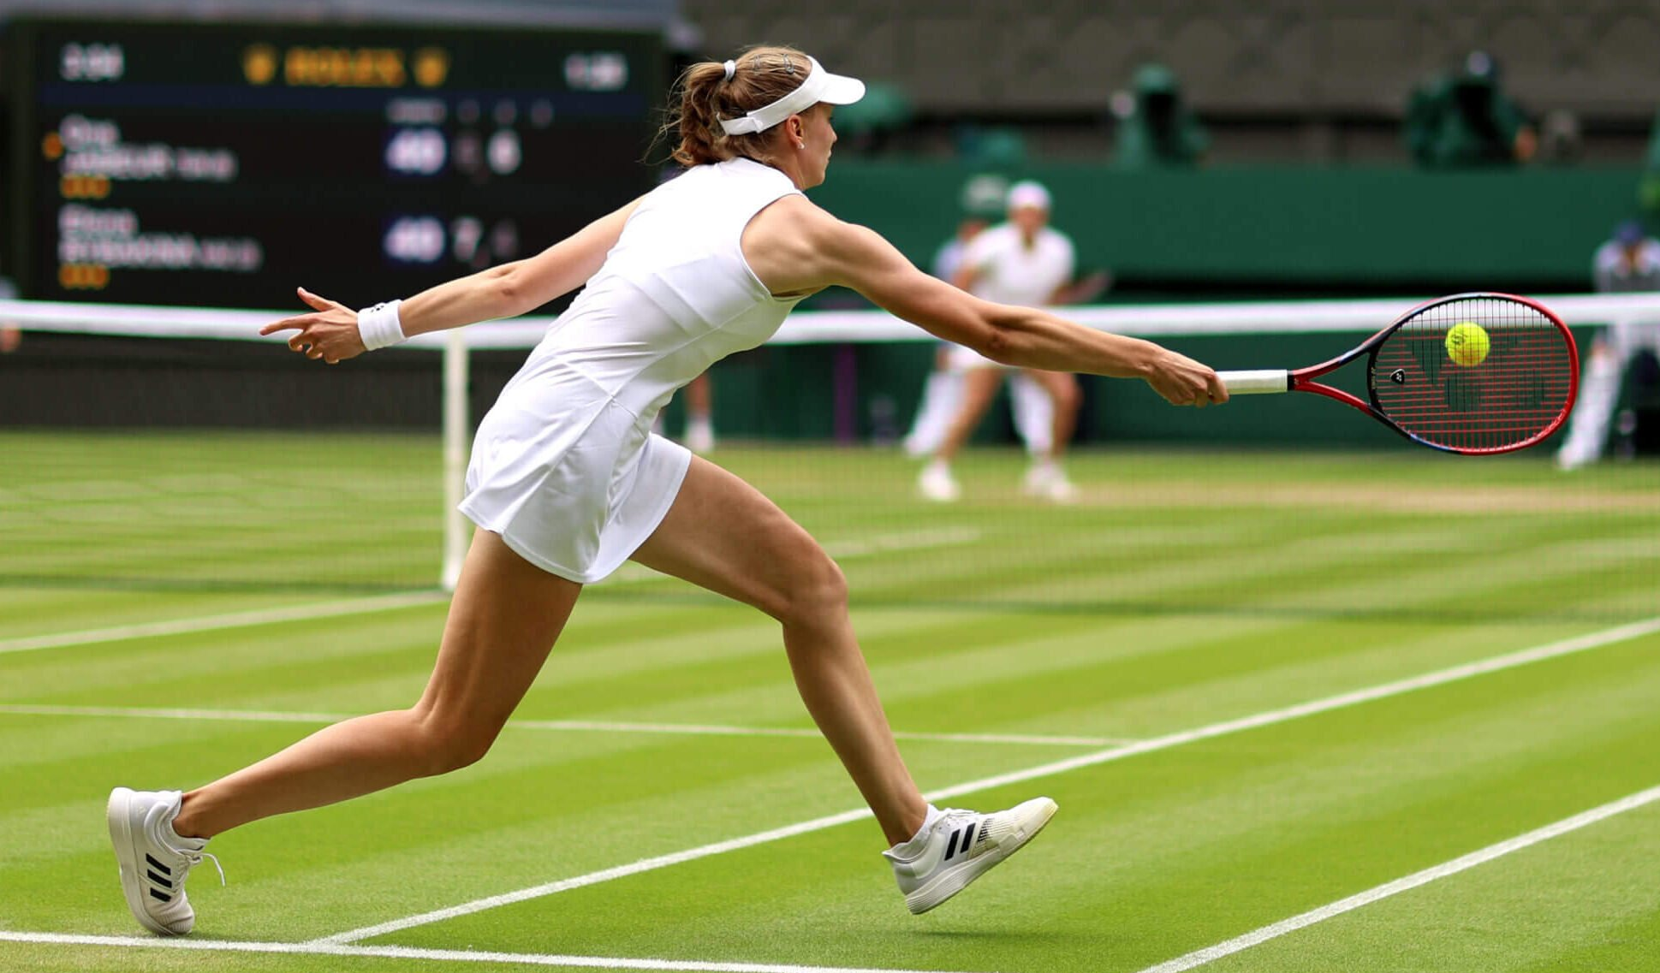
Introduction
SUPERVISED

Slide 26

Subset Chosen
Target Variable
Player Attributes
Match-Specific Details
win
player_ht
player_age
player_hand_R
player_rank
opponent_ht
opponent_age
opponent_hand_R
opponent_rank
grand_slam
final_rounds
set1_p_win
surface_grass
surface_clay
minutes

Slide 27
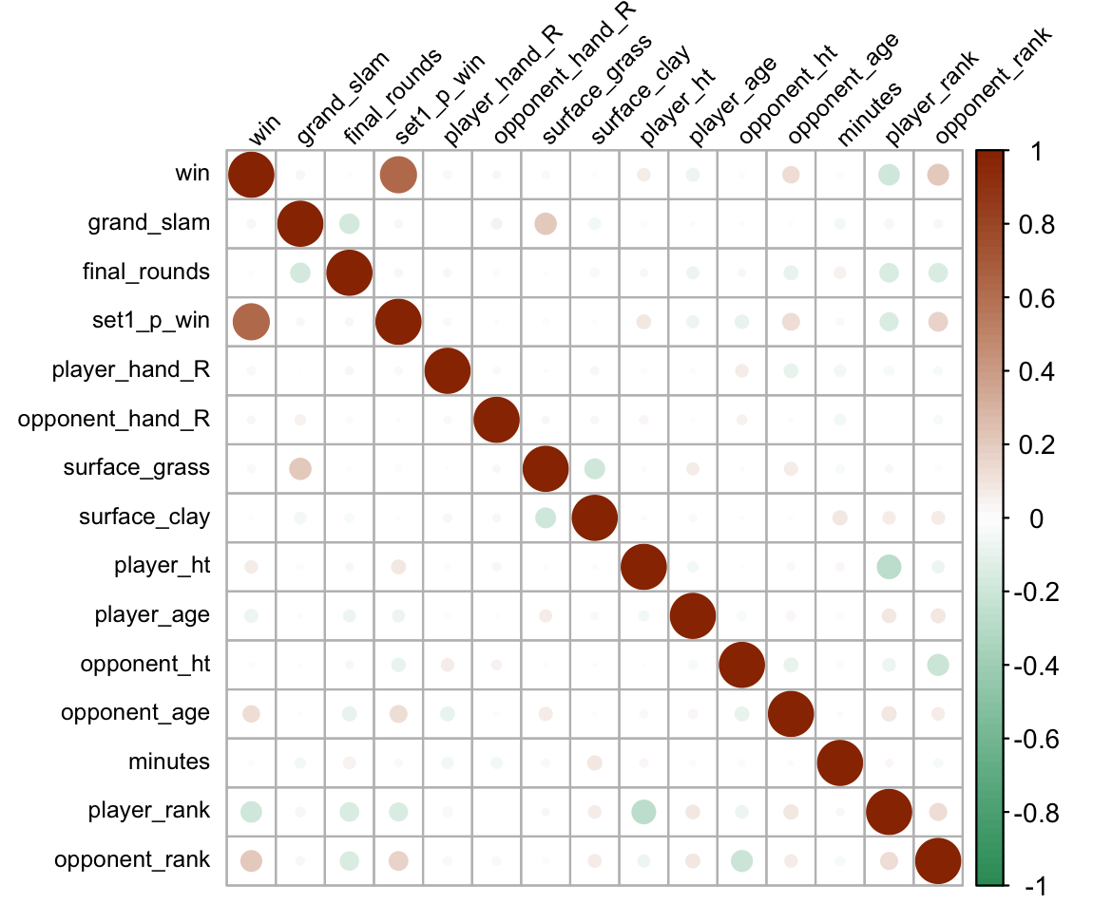
Logistic Regression
🎾 After verifying the assumptions (Binary Outcome, Independence of Observations, Linearity of Log Odds, and No Multicollinearity), I conducted the following correlation analysis.
🎾 The variable "win" displays the strongest correlation with "set1_p_win", followed by "player_rank" and "opponent_rank", and then by "opponent age". Moreover, "player_age" and "player_ht" exhibit some correlation with the target variable, although it is comparatively weaker.

Slide 28
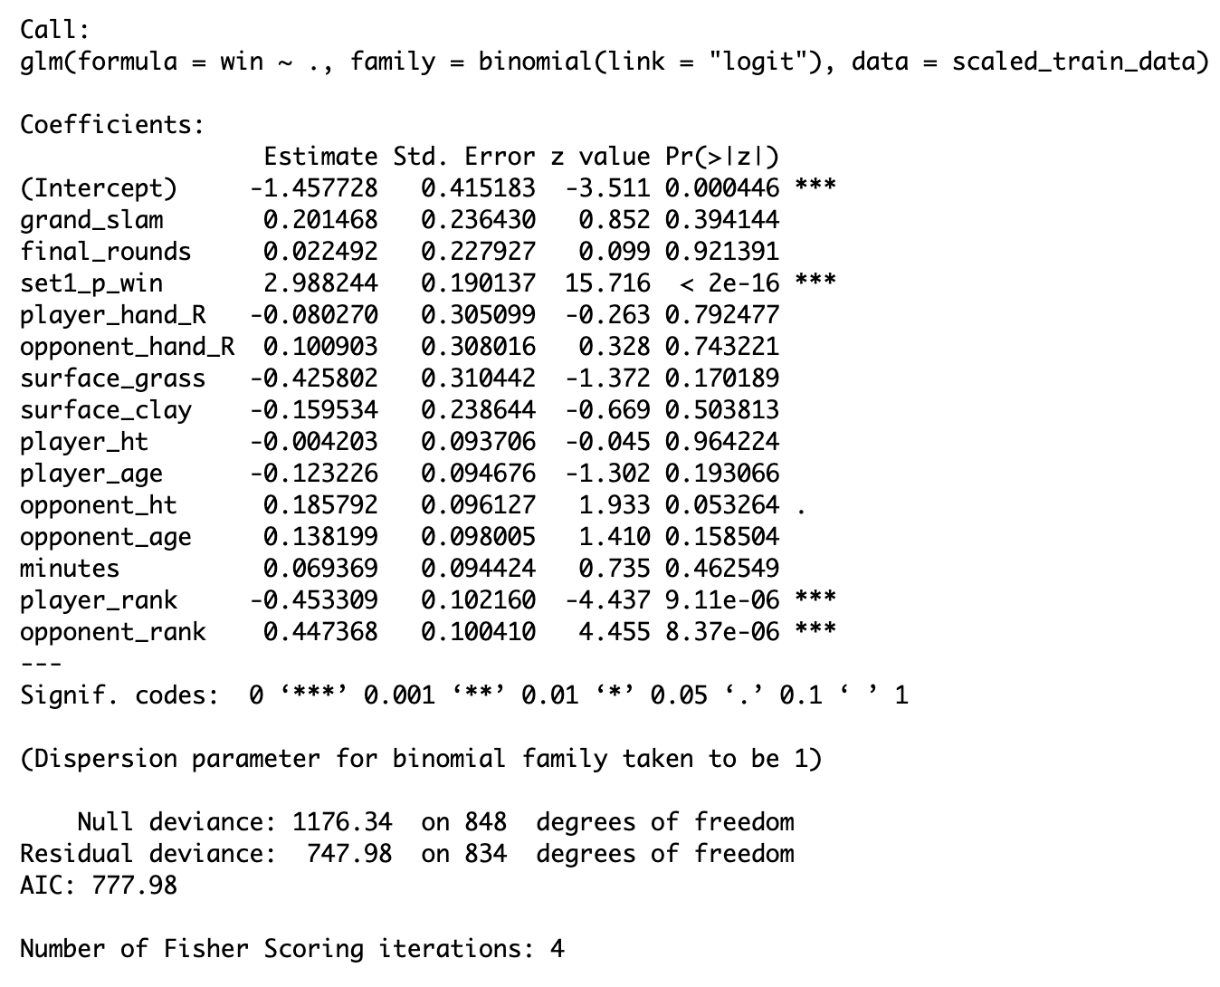
Logistic Regression - Full Model
🎾 Before starting the analysis, I partitioned the subset into an 80% training set and a 20% test set.
🎾 In the initial phase, I executed the logistic regression model with all variables present in the subset. Among these, “set1_p_win”, “player_rank”, and “opponent_rank” emerged as statistically significant predictors, demonstrating significance at conventional levels. Notably, “opponent_ht” also exhibited statistical significance, albeit at a 10% significance level.

Slide 29
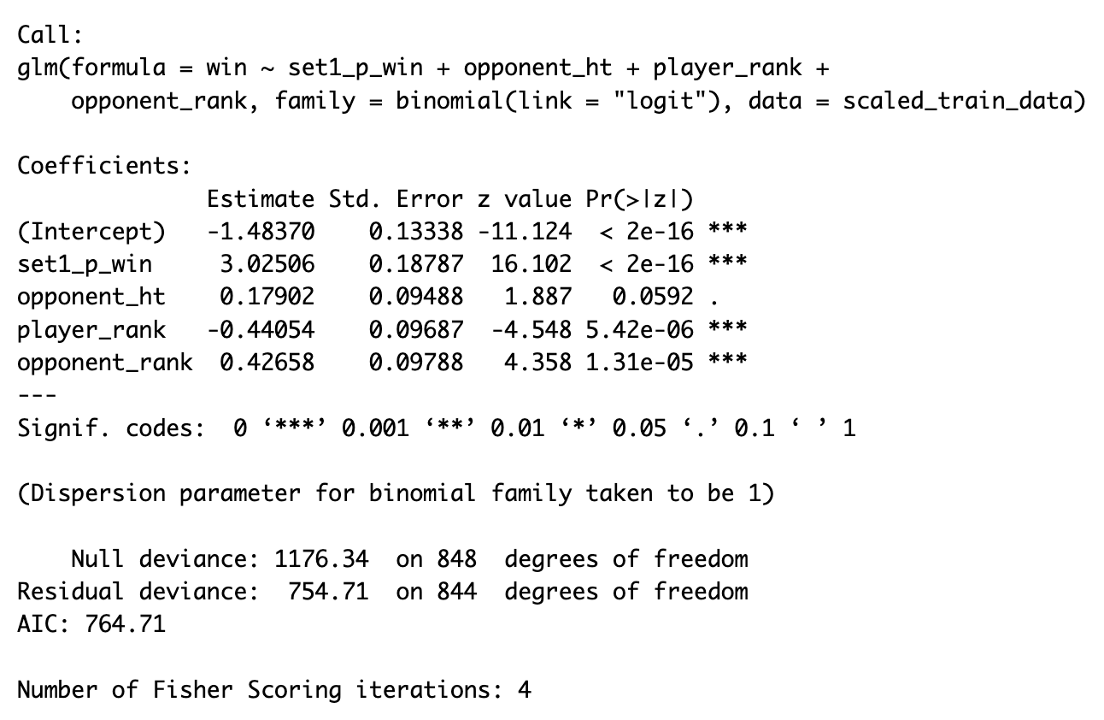
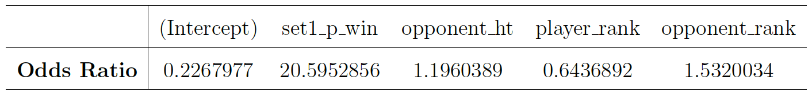
Logistic Regression - Reduced Model
🎾 Players who win the 1st set have approximately 20.6 times higher odds of winning the match.
🎾 With every 1 cm increase in the opponent’s height, the odds of winning the match increase by a factor of approx. 1.2.
🎾 Each unit increase in the player’s ranking corresponds to a decrease in the odds of winning by a factor of approx. 0.64.
🎾 With every 1 unit increase in the opponent’s ranking, the odds of winning increase by a factor of approximately 1.53.

Slide 30
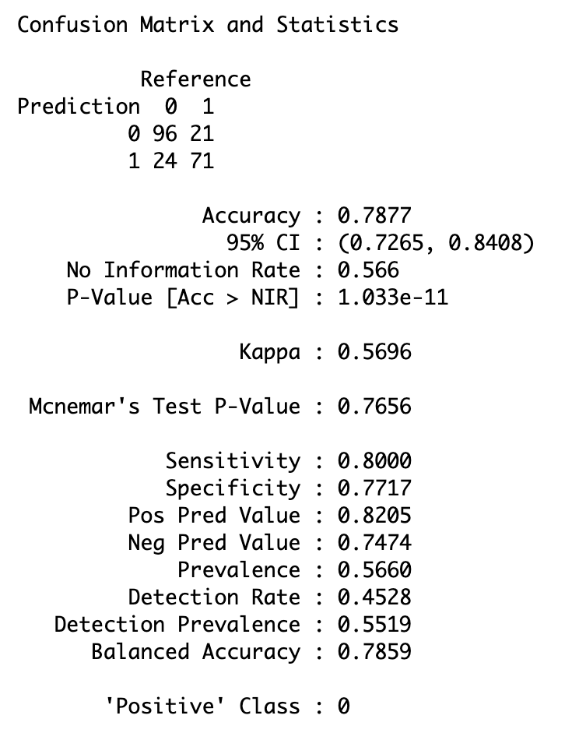
Logistic Regression - Prediction Accuracy
TP
FP
FN
TN
🎾 The overall accuracy of the model is 0.7877, indicating that it correctly predicts
78.77% of the cases.
🎾 The confidence interval for the accuracy provides a range within which the
true accuracy is likely to fall. In this case, it ranges from 0.7265 to 0.8408.
🎾 Sensitivity, also known as the “True Positive Rate”, measures the proportion of
actual positives correctly identified by the model. In this context, it stands at
0.8000, indicating that the model correctly identifies 80% of the positive cases.
🎾 Specificity, or the “True Negative Rate”, measures the proportion of actual negatives correctly identified by the model. With a specificity of 0.7717, the model
accurately identifies 77.17% of the negative cases.

Slide 31
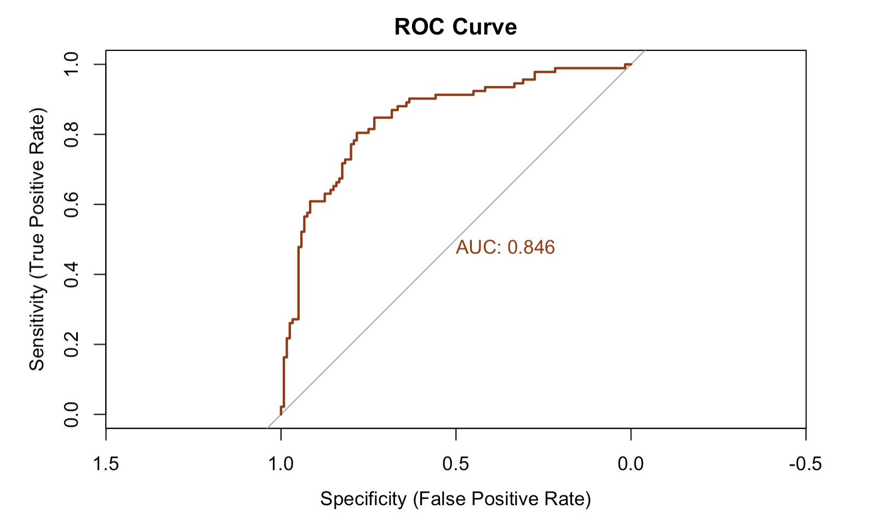
Logistic Regression - Prediction Accuracy
🎾 the AUC is calculated as 0.846. This means that there is an 84.6% chance
that the model will be able to distinguish between positive and negative outcomes. In other words, the model has a good discriminatory ability, with a higher probability of correctly ranking a randomly chosen positive instance higher than a randomly chosen negative instance.

Slide 32
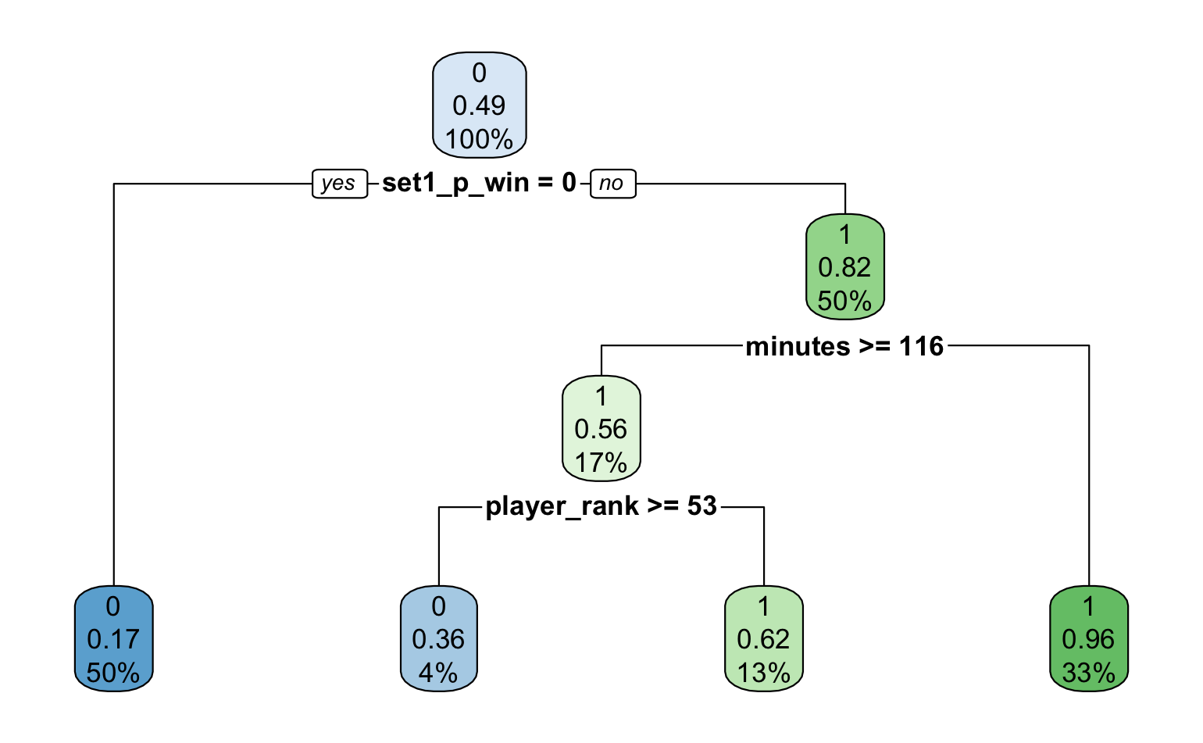
Classification Tree
🎾 If the player loses the 1st set, she’s most likely to lose the match. However, If she wins the 1st set, we should consider additional factors like match duration, and player rank.
🎾 If match duration is < 116, it’s more likely to be a win for the player who won the 1st set.
🎾 If match duration is > 116, it’s more likely to be a competitive match. We consider the player rank.
🎾 If the player is higher ranked (<53), it predicts a win. Else, it’s a loss.

Slide 33
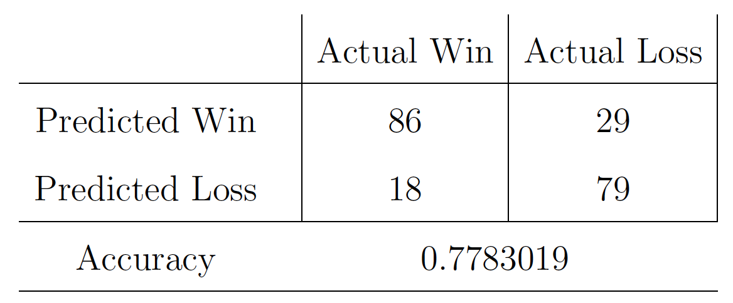
Classification Tree - Prediction Accuracy
TP
FP
FN
TN
🎾 The model correctly predicts 86 instances as “Win” (True Positives), but misclassifies 29 instances as ”Win” when they are actually ”Loss” (False Positives).
🎾 18 instances are erroneously predicted as “Loss” when they are ”Win” (False Negatives), while 79 instances are correctly classified as “Loss” (True Negatives).
🎾 Calculating the accuracy, which is the proportion of correct predictions out of the total instances, yields a value of 0.7783019, indicating that the model achieves an accuracy rate of approximately 77.83%.

Slide 34
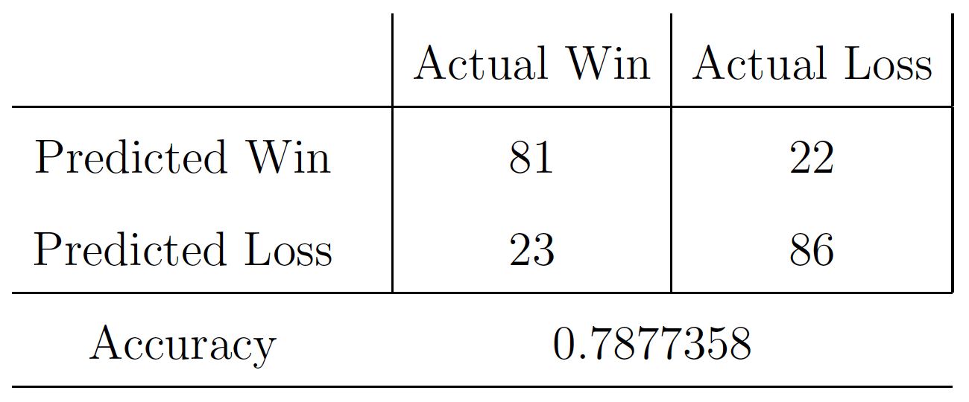
Classification Tree - Prediction Accuracy
TP
FP
FN
TN
🎾 The model correctly predicts 81 instances as “Win” (True Positives), but misclassifies 22 instances as ”Win” when they are actually ”Loss” (False Positives).
🎾 23 instances are falsely predicted as “Loss” when they are ”Win” (False Negatives), while 86 instances are correctly classified as “Loss” (True Negatives).
🎾 Calculating the accuracy yields a value of 0.7877358, indicating that the model achieves an accuracy rate of approximately 78.77%.

Slide 35
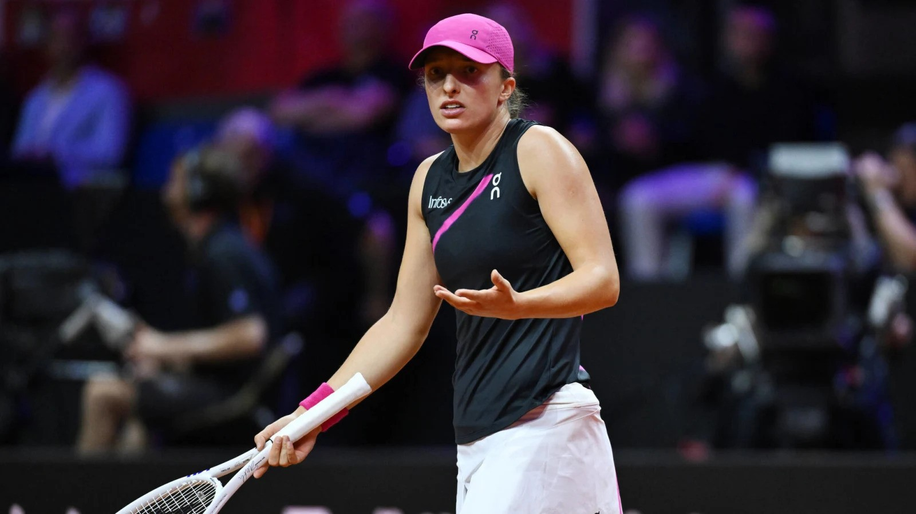
CHALLENGES

Slide 36
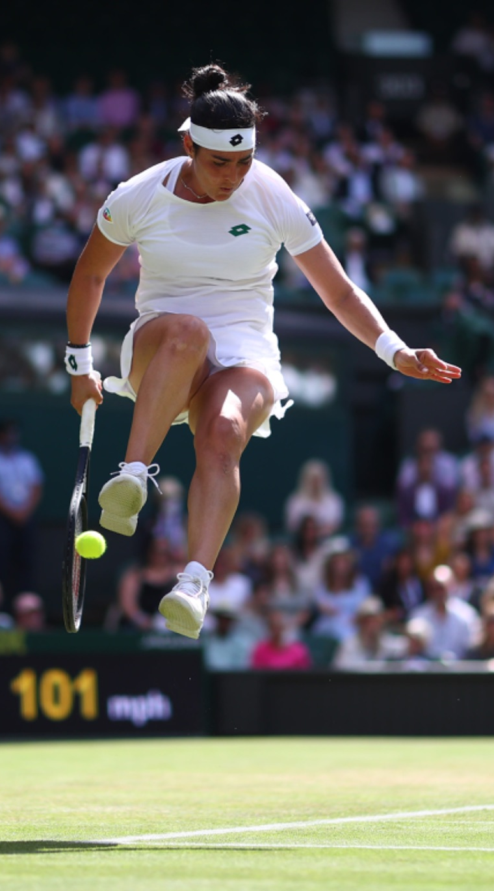
Unsupervised Learning
Granularity:
One challenge lies in refining the granularity of clustering analysis to capture the diverse performance profiles of players. This includes considering factors such as player performance on different surfaces (e.g., grass, clay), in various tournament rounds (e.g., final rounds), and across different tournament types (e.g., grand slam tournaments). By incorporating these nuances, we can ensure that the clustering analysis accurately identifies meaningful player segments.
Temporal Relevance:
Another challenge is addressing the temporal relevance of historical player statistics in the clustering process. Traditional clustering methods may overlook the dynamic nature of player performance over time, leading to potentially outdated or less relevant cluster assignments. Implementing techniques to incorporate temporal trends and prioritize recent performance data could enhance the accuracy and relevance of the clustering results.

Slide 37
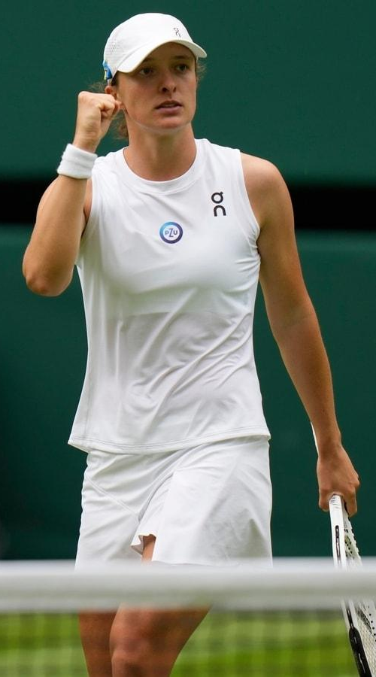
Supervised Learning
Temporal Discounting:
In supervised learning for predicting match outcomes, a significant challenge is mitigating temporal discounting, where historical match data may become less relevant over time. Techniques such as time-weighted feature averaging and incorporating time decay functions can help address this challenge and ensure that the predictive models remain relevant and accurate over time.
Feature Relevance and Selection:
Another challenge is selecting relevant features for predicting match outcomes. While the provided features offer valuable insights into player characteristics and match conditions, there may be additional factors influencing outcomes (e.g., player form, recent performance trends, injuries). Incorporating domain-specific knowledge could help identify these factors, enhancing predictive models' power and robustness.

Slide 38
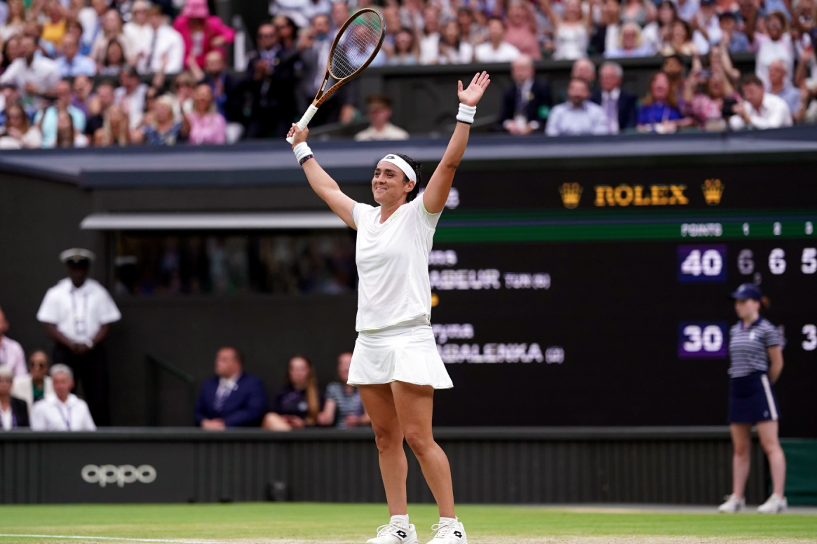


Introduction
THANK YOU
in/samaherbrahem
github.com/SamaherUNIMI
samaherbrahem.com

